Slide 1
SARSA
BITS F327 – Artificial Intelligence for Robotics
End Semester Presentation
Udandra Rohith Siddhartha
2019A4PS0683H

Slide 2
What is SARSA?
State–action–reward–state–action (SARSA) is an algorithm for learning a Markov decision process policy, used in the reinforcement learning area of machine learning.
This name simply reflects the fact that the main function for updating the Q-value depends on the current state of the agent "S₁", the action the agent chooses "A₁", the reward "R" the agent gets for choosing this action, the state "S₂" that the agent enters after taking that action, and finally the next action "A₂" the agent chooses in its new state. The acronym for the tuple (s_{t}, a_{t}, r_{t}, s_{t+1}, a_{t+1}) is SARSA.
SARSA algorithm is a slight variation of the popular Q-Learning algorithm.

Slide 3
SARSA is an on-policy value-based approach which means the learning agent learns the value function according to the current action derived from the policy currently being used.
For a learning agent in any Reinforcement Learning algorithm it’s policy can be of two types:-
On Policy: In this, the learning agent learns the value function according to the current action derived from the policy currently being used.
Off Policy: In this, the learning agent learns the value function according to the action derived from another policy.
Q-Learning technique is an Off Policy technique and uses the greedy approach to learn the Q-value. SARSA technique, on the other hand, is an On Policy and uses the action performed by the current policy to learn the Q-value.

Slide 4
Reinforcement Learning
Reinforcement Learning is a type of Machine Learning. It allows machines and software agents to automatically determine the ideal behavior within a specific context, in order to maximize its performance. Simple reward feedback is required for the agent to learn its behavior
A learning agent learns, overtime, to behave optimally in a certain environment by interacting continuously in the environment. The agent during its course of learning experience various different situations in the environment it is in. These are called states. The agent while being in that state may choose from a set of allowable actions which may fetch different rewards(or penalties). The learning agent overtime learns to maximize these rewards so as to behave optimally at any given state it is in.

Slide 5
Q-learning
Q-Learning is a basic form of Reinforcement Learning which uses Q-values (also called action values) to iteratively improve the behavior of the learning agent.
Q-Values or Action-Values: Q-values are defined for states and actions. Q(S, A) is an estimation of how good is it to take the action A at the state S. This estimation of Q(S, A) will be iteratively computed using the TD- Update rule which we will see in the upcoming sections.

Slide 6
Temporal Difference or TD-Update:
This update rule to estimate the value of Q is applied at every time step of the agents interaction with the environment. The terms used are explained below :
S : Current State of the agent.
A : Current Action Picked according to some policy.
S' : Next State where the agent ends up.
A' : Next best action to be picked using current Q-value estimation, i.e. pick the action with the maximum Q-value in the next state.
R : Current Reward observed from the environment in Response of current action.
gamma(>0 and <=1) : Discounting Factor for Future Rewards. Future rewards are less valuable than current rewards so they must be discounted. Since Q-value is an estimation of expected rewards from a state, discounting rule applies here as well.
alpha : Step length taken to update the estimation of Q(S, A).

Slide 7
Choosing the Action to take using epsilon-greedy policy:
epsilon-greedy policy of is a very simple policy of choosing actions using the current Q-value estimations. It goes as follows :
With probability (1-ε) choose the action which has the highest Q-value.
With probability (ε) choose any action at random.

Slide 8
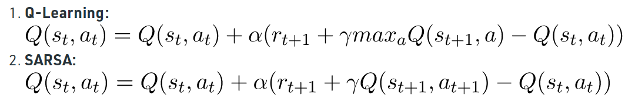
SARSA from Q-learning
This difference is visible in the difference of the update statements for each technique:-
Here, the update equation for SARSA depends on the current state, current action, reward obtained, next state and next action. This observation lead to the naming of the learning technique as SARSA stands for State Action Reward State Action which symbolizes the tuple (s, a, r, s’, a’).

Slide 9
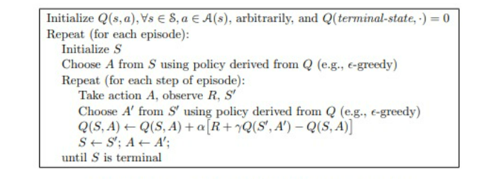
The SARSA Algorithm

Slide 10
Algorithm Explanation
For a given problem create an environment of the problem with different states and the agent in it.
Define the set of states(S) and a set of all possible actions over the states(A)
An episode is a set of sequence of state action pairs with rewards. For example the sequence of an agent moving from the start state to the goal state and collecting rewards at each state is an episode.
Ex: s1,a1,r1,s2,a2,r2,……….,sn,an,rn

Slide 11
Now for each episode repeat the following steps -
Initialize the Q-values Q(s,a) for all the state-action pairs where s ∈ S and a ∈ A
Initialize the state i.e. choose the starting state (s) of the agent
Now in the state (s) choose an action (a) from the set A using the policy derived from Q. Here the policy used is the epsilon greedy policy (ε-greedy policy)

Slide 12
Now for each step in the episode repeat the following steps –
For the chosen action (a) observe the reward (r) and the next state (s’) the agent moves to.
In the state (s’) choose an action (a’) using the same ε-greedy policy
Update the Q(s,a) values using the following TD-rule-
Update the action and state as
state (s) = next state (s’)
action (a) = next action (a’)
End the loop when the state becomes terminal i.e. agent reaches the goal state

Slide 13
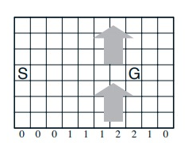
Application – Windy Gridworld
Windy Gridworld is a standard gridworld, with start and goal states, but with one difference: there is a crosswind upward through the middle of the grid. The actions are the standard four—up, down, right, and left —but in the middle region the resultant next states are shifted upward by a "wind," the strength of which varies from column to column. The strength of the wind is given below each column, in number of cells shifted upward.

Slide 14
SARSA in Windy Gridworld
An agent can be trained to work in this environment (Windy gridworld) using SARSA
Consider an episode in which the agent’s task is to move from the start grid to goal grid
For every step that the agent makes a reward of -1 is given and the agent collects these rewards through the entire episode
The agent tries to maximize the total reward by trying to minimize the number of steps it take to reach the goal grid
By applying SARSA to this problem we can make the agent learn the optimal solution (shortest path) by making it interact with the environment for a number of episodes

Slide 15
Coding the SARSA algorithm
A SARSA algorithm can be coded for solving specific problems of reinforcement learning
Here we code the SARSA algorithm for out windy gridworld problem
And we use this algorithm to train the agent to behave optimally in the windy grid environment

Slide 16
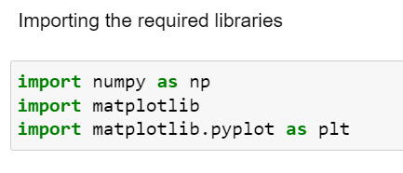
Importing the Required libraries
Here the required libraries are imported
Numpy – For solving mathematical equations and for some other purposes
Matplotlib – For generating the plots and saving them into pictures etc.

Slide 17
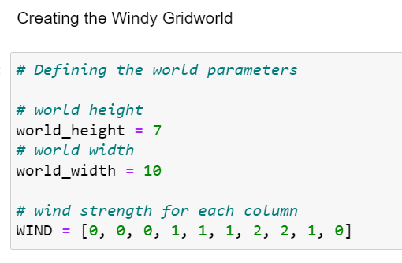
Creating the Windy Gridworld
The Windy gridworld is created by this code.
world_height and world_width define the dimensions of the gridworld
The strength of wind in different columns is defined using a list

Slide 18
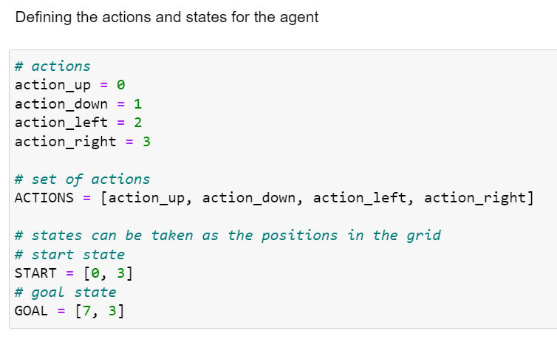
Defining the states and actions
Here the actions and states are defines for the agent.
Actions are up, down, left and right
States are given by the grid positions in the world. For example (3,6) is a state
Also, the start state and the goal state are defined

Slide 19
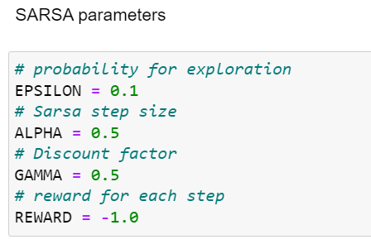
Defining the SARSA parameters
Here the SARSA parameter are defined. These are used in the TD-update rule in Q-value update equation
EPSILON is the probability used in epsilon-greedy policy
ALPHA is the step length
GAMMA is the discount factor

Slide 20
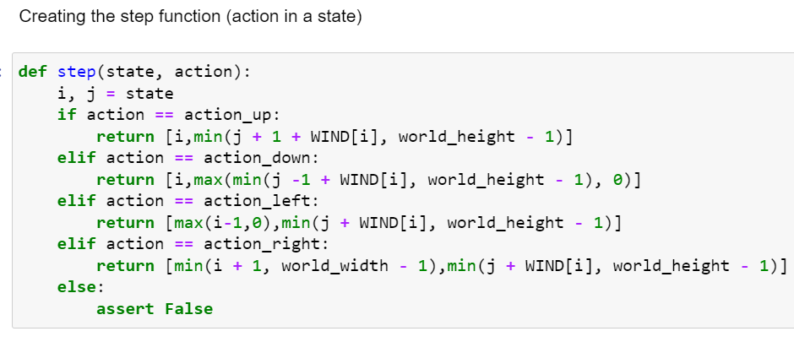
Step Function
This is the function using which the agent takes an action (step) in the gridworld.
The action results are based on the given action and the strength of the wind in that column
This function returns the resultant state in which the agent ends up by taking the action

Slide 21
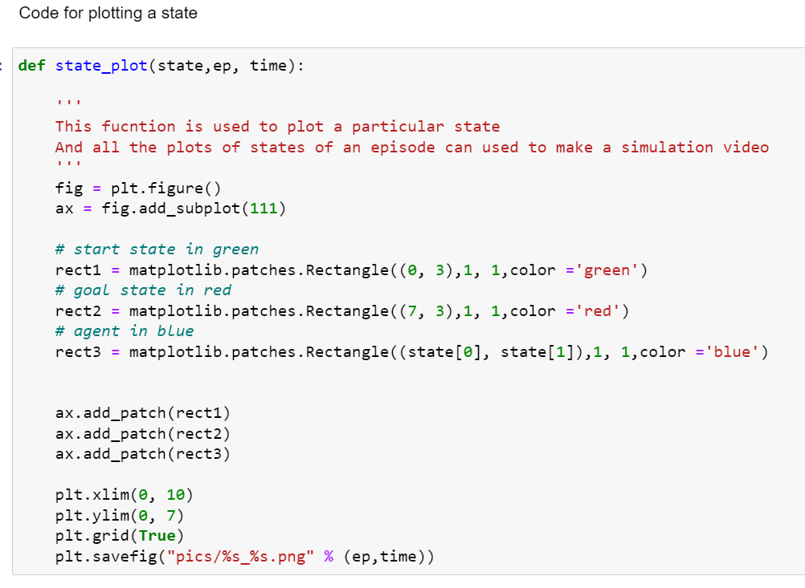
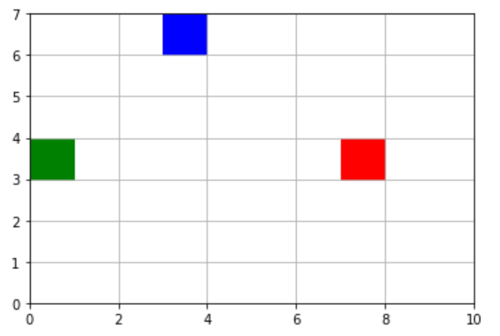
Plotting a state
This function plots a the current state of the world. This is just used for generating images and video for simulation purpose
For example -

Slide 22
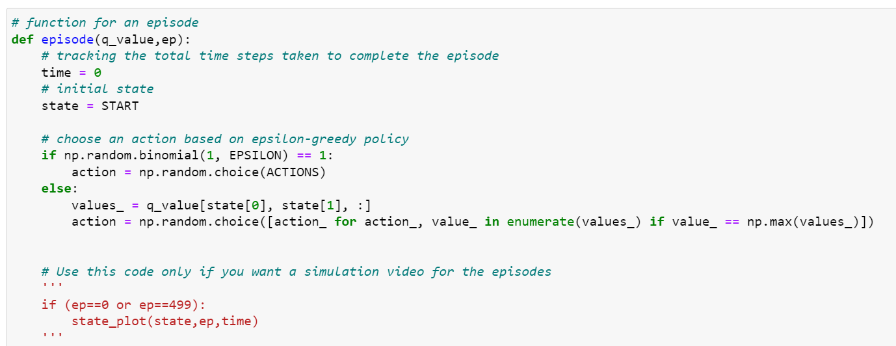
Episode
An episode is the task to going from start state to the goal state
The initial Q-values are given as input the episode function
The agent keeps updating the Q-values through the episode as it interacts with the environment

Slide 23
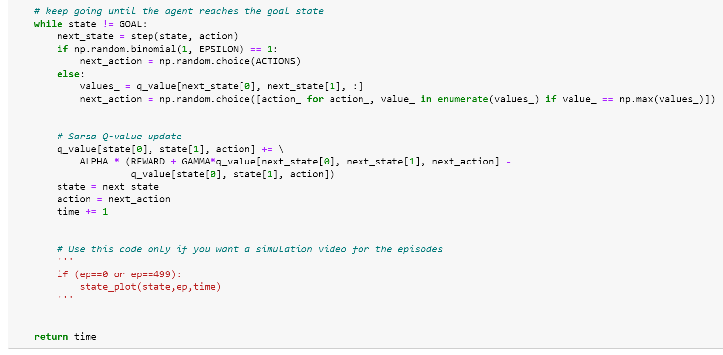
The Q-value update equation can be seen here. After every action the Q-value of the previous state-action pair is updated
For every episode the number of time steps taken is also noted and used for the results and analysis

Slide 24
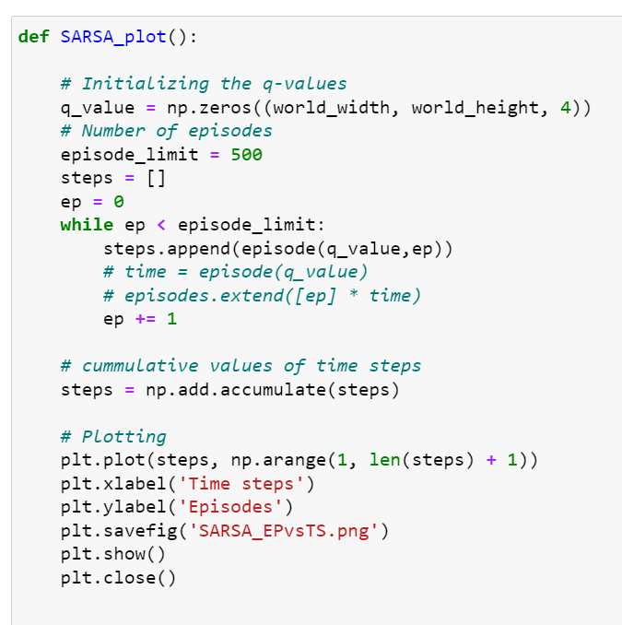
Running 500 episodes
500 episodes are executed with improved Q-values every time as input to each episode
After 500 episodes the optimal policy or the optimal solution/path is obtained
The number of time steps are accumulated and a plot of number of episodes is plotted against timesteps

Slide 25
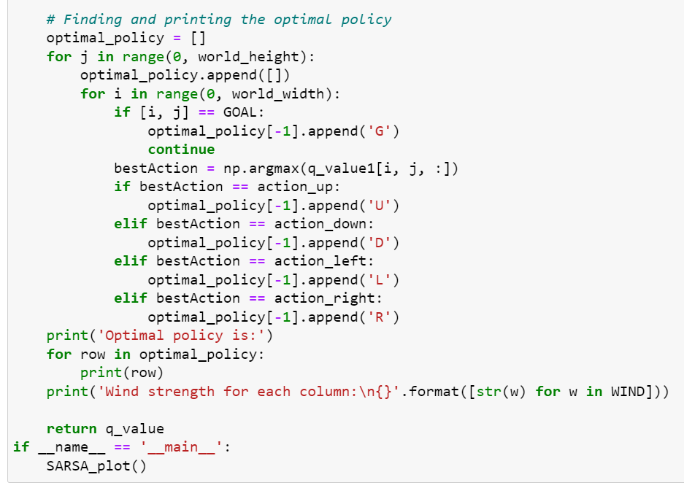
The optimal policy (solution) is also obtained and printed with this code
Two simulation videos are also generated for the 1st episode and the final (500th) episode to show the improved performance of the agent
And the code ends here

Slide 26
Simulation, Results and Analysis
The following are obtained for simulation and results
The number of vs episodes vs time steps graph
The optimal policy (solution)
The simulation video of the first episode
The simulation video of the last episode
The results and analysis are discussed in the next slides along with the simulation

Slide 27
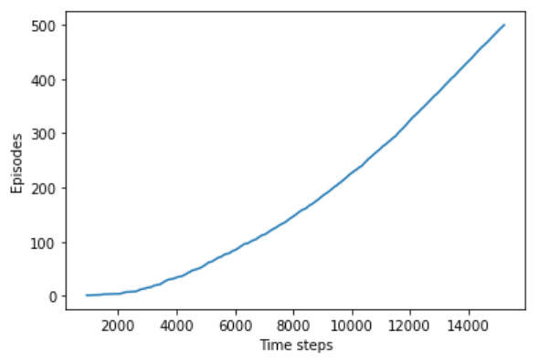
No. of Episodes vs time steps
The number of episodes vs time steps plot is obtained like this
Around 15000 time steps were required for 500 episodes
The first 100 episodes took 6000 steps to complete where as the last 100 episodes took just around 1000 episodes
You can understand this by the increasing slope

Slide 28
No. of Episodes vs time steps
After 300 episodes the slope is almost constant till the end. This indicates that the optimal solution would’ve obtained somewhere after 300 episodes
It can be understood that the time steps taken to complete an episode is reduced with number of episodes
So we can say that the performance of the agent has been improved

Slide 29
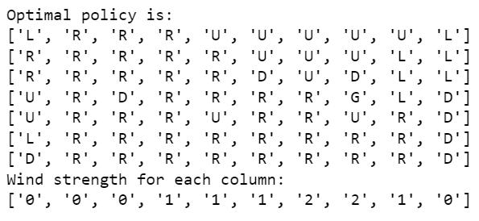
The optimal policy
The optimal policy is obtained is shown here
At each state it shows the action to be taken to reach the goal in optimal time
U,D,L,R represent the actions up, down, left and right respectively

Slide 30
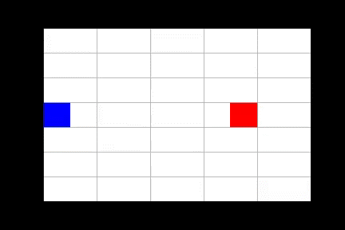
The first episode
The first episode is where the agent has to start in a completely new world
It takes a lot of time to complete the episode
Here it has taken 993 time steps to complete the first episode
And this number keeps decreasing along with episodes

Slide 31
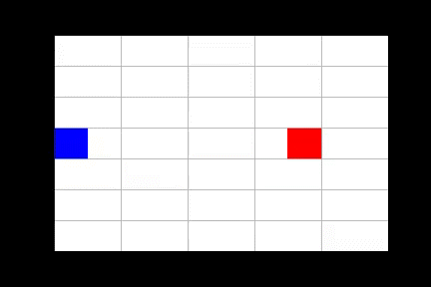
The final episode
By the final episode the agent has learnt the world and it is behave optimally in this environment
It just took 21 time steps to complete the final episode
And it can be said that the agent’s performance is improved

Slide 32
Conclusion
In the windy gridworld we have seen how the agent has learned to behave optimally in the environment using SARSA
This is reinforcement learning is all about. Reinforcement learning is used to make agents train themselves by interacting with the environment
SARSA is one popular algorithm used in the reinforcement learning

